Slide 1
The Battle Of Neighborhoods
Recommending locations for a Japanese Restaurant

Slide 2
Introduction and Problem Overview
Background:
Location is key for restaurant success.
Project goal: Build a model that recommends best locations for a Japanese restaurant.
Problem Description:
Several factors to be considered: Is the location prime? Are there other Japanese or sushi restaurants as competition? Would a Japanese restaurant “fit in”? What are the nearby attractions?
Target Audience:
Entrepreneurs / Restaurateurs.
Success Criteria:
Provide a Yes/No Recommendation on Toronto neighborhoods based on above factors.

Slide 3

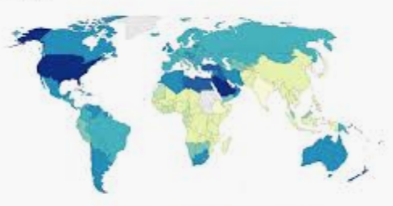
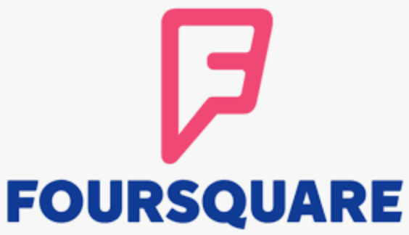
Data Acquisition and Cleaning
List of postal codes scraped from Wikipedia https://en.wikipedia.org/wiki/List_of_postal_codes_of_Canada:_M
Geospatial data using Python geocode library or csv http://cocl.us/Geospatial_data/Geospatial_Coordinates.csv
Venues data using Foursquare API https://developer.foursquare.com/docs/places-api/endpoints/
Data cleaning & filtering done Drop ’Not Assigned’ boroughs. Default Neighborhood to borough if ‘Not Assigned’. Group duplicate rows. Filtered boroughs containing the word ‘Toronto’
Cleaned and filtered data contained 39 rows (neighborhoods) and 235 columns (features).

Slide 4
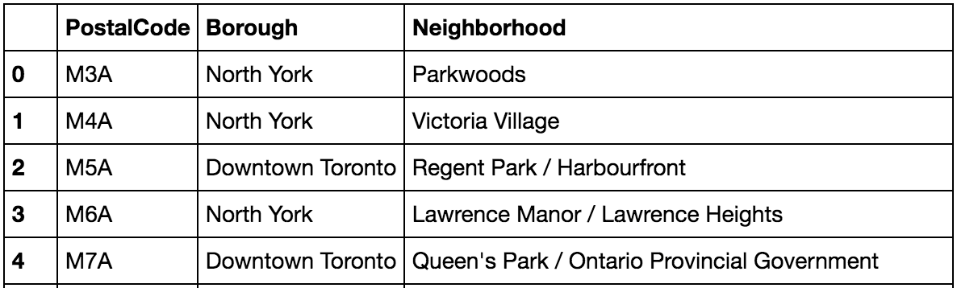
Methodology – Explore and Analyze data (1)
Data 1 - Get list of Postal Codes, Boroughs and Neighborhoods in Toronto, Canada by scraping Wikipedia
https://en.wikipedia.org/wiki/List_of_postal_codes_of_Canada:_M
Used BeautifulSoup library to scrape Wikipedia and transformed data into a Pandas dataframe.
After data cleaning, dataframe contained 103 rows and 3 columns

Slide 5
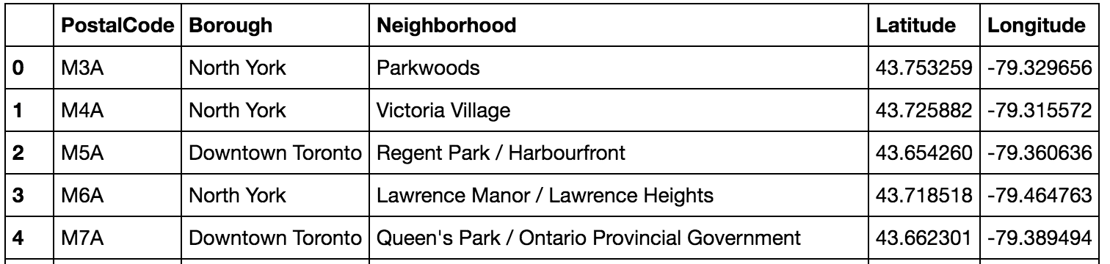
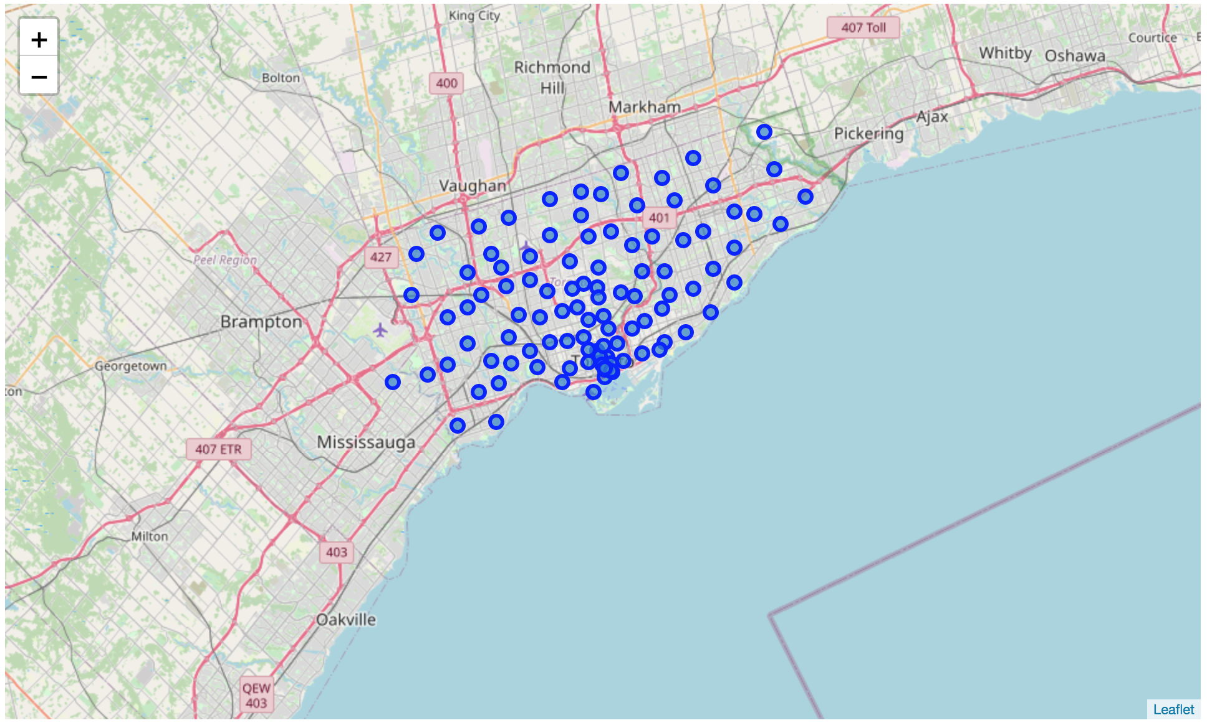
Methodology – Explore and Analyze data (2)
Data 2 – Get Geospatial data from Python geocoder library or CSV. Add Latitude and Longitude.
Used Folium library to create a map and visualize all Toronto neighborhoods
Decided to work with only boroughs containing the word ‘Toronto’. After filtering data, got 39 postal codes

Slide 6
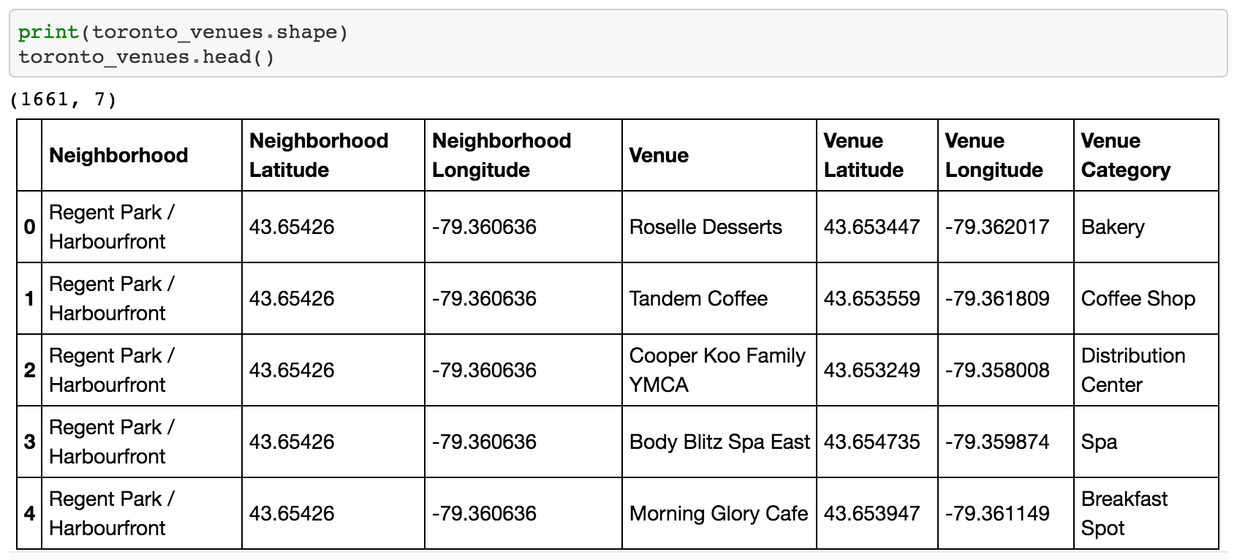
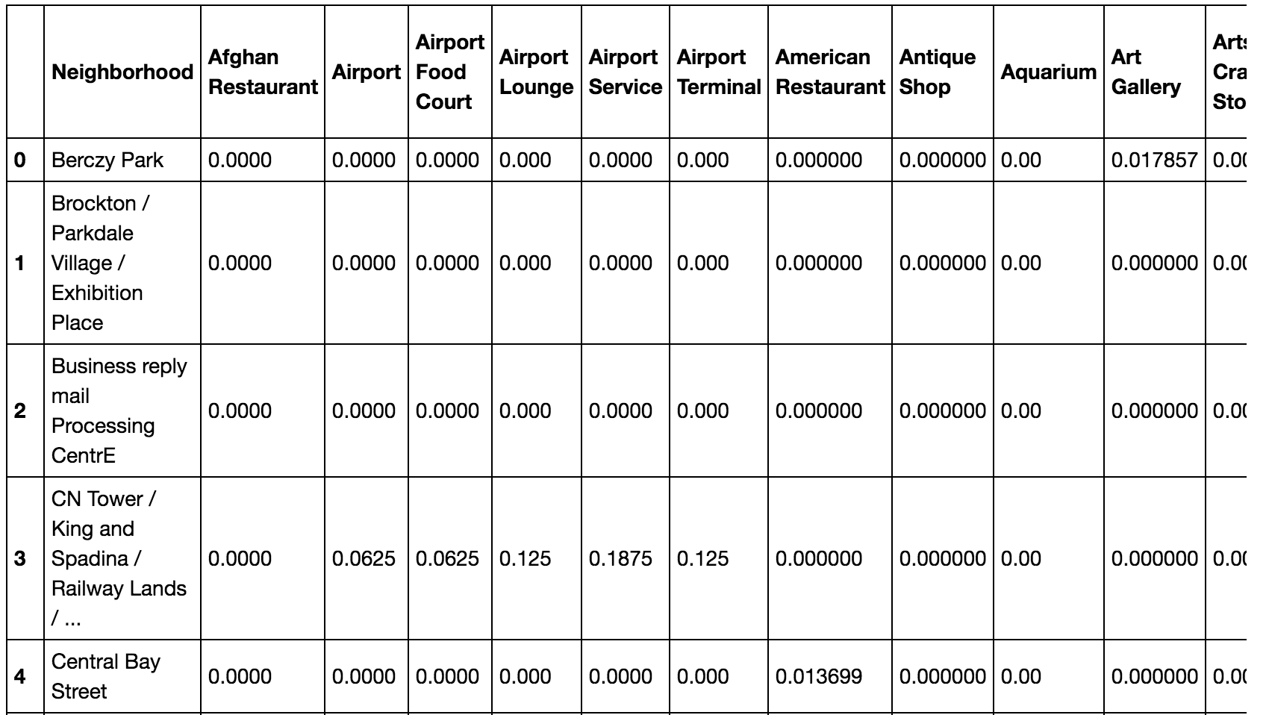
Methodology – Explore and Analyze data (3)
Data 3 – Explored neighborhoods by grabbing venues data from Foursquare API.
After performing One-Hot encoding and grouping data by Neighborhood, dataframe contained 38 rows X 235 columns (features) Note – One neighborhood did not have venues data, hence 38 instead of 39.

Slide 7
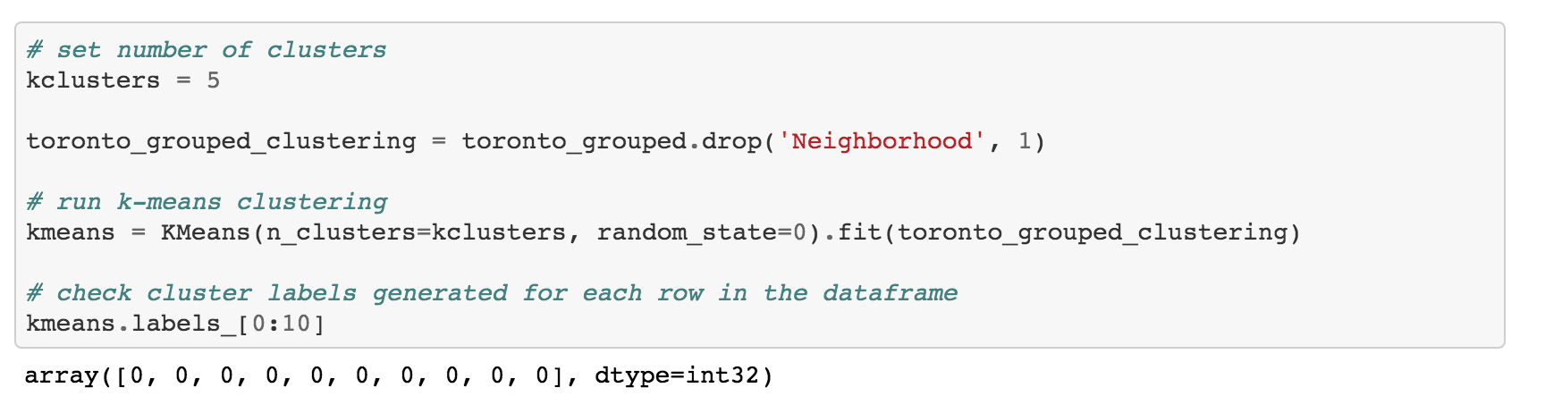
Methodology – Predictive Modeling
Used K-Means unsupervised machine learning algorithm to segment and cluster neighborhoods.
Set number of clusters, k to 5 and random state to 0. Modeling step included fitting our dataframe and getting an array of cluster labels as output.

Slide 8
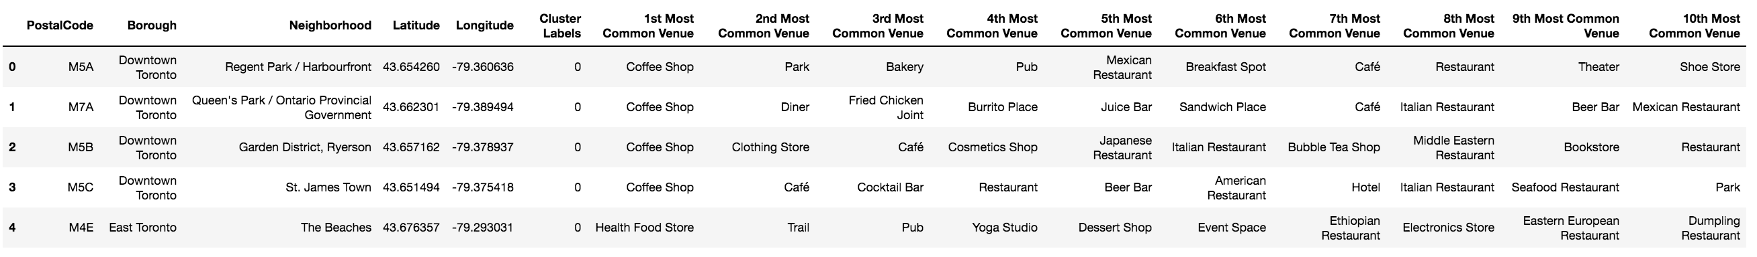
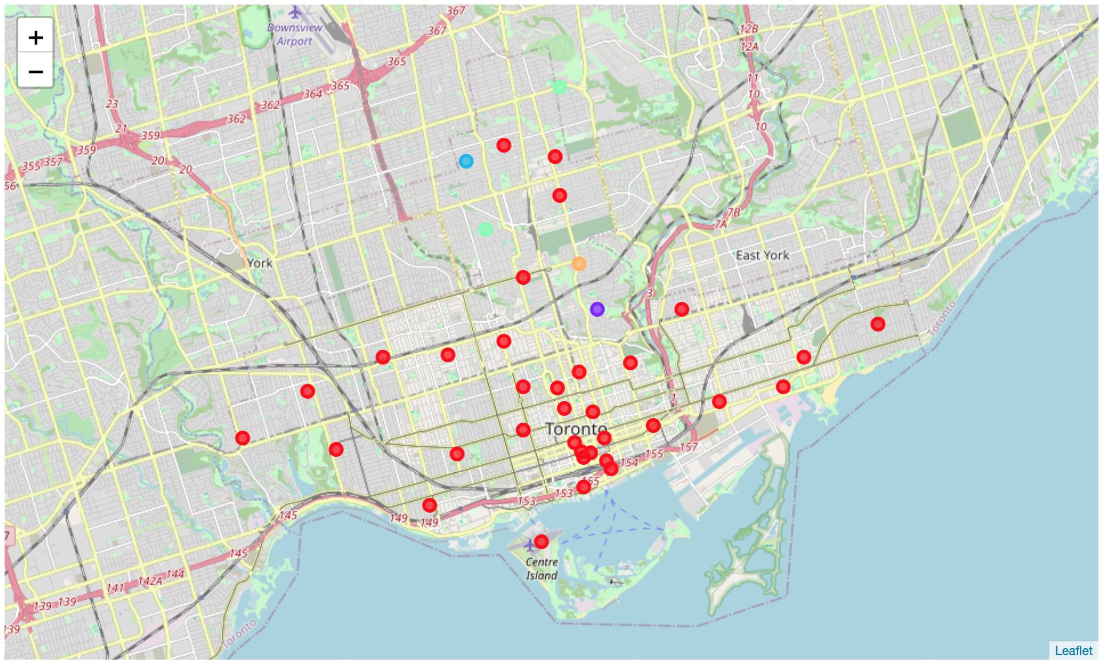
Results (1) – Create observation table
Create results / observation table by merging previous dataframes and inserting Cluster Labels
Using Folium to visualize the clusters.
Used 5 different colors as we have 5 clusters
Performed analysis on the clusters to understand neighborhood segments and types

Slide 9
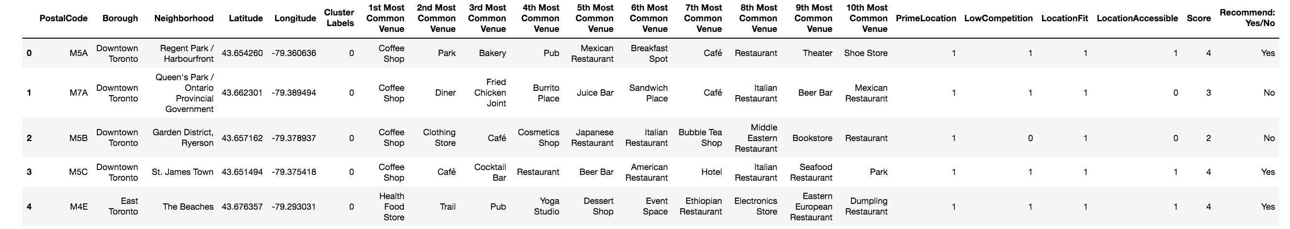
Results (2) – Final Observation Table
Applied multiple criteria to further refine results and recommend locations appropriate for a Japanese restaurant.
PrimeLocation – Cluster 0 (has max neighborhoods) considered prime
LowCompetition – No Japanese or Sushi restaurant in neighborhood
LocationFit – No freeway, rail station, airport, or fast food restaurant nearby
LocationAccessible – Check if there are parks, hotels, tourist attractions nearby
Add up scores and provide Recommend: Yes/ No. Recommend locations with a total score of 4.

Slide 10
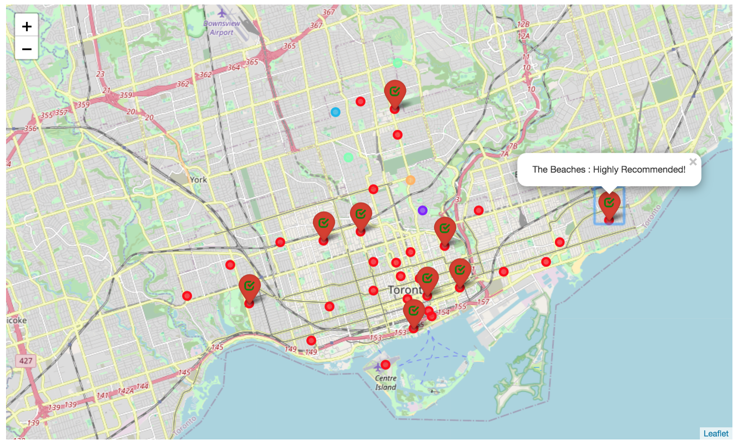
Results (3) – Final Visualization Map

Slide 11
Discussion
Used KMeans algorithm as part of this clustering study. Many different unsupervised clustering approaches can be adopted to improve accuracy.
Scope to add Toronto demographics data to get details about population count, income or ethnicity by neighborhood.
Worked with 235 features. Having more samples may result in better clustering.

Slide 12
Conclusion
Restaurant business is a highly competitive business with high failure rate. Being able to recommend locations for opening a Japanese restaurant is a very useful tool for first time entrepreneurs.
Methodology and approaches used in this project can be extended to other applications:
Recommend locations for any type of business
Build other recommender systems – for example, matching venues with customers when combined with customer preferences data
The list is endless…..!

